Slide 1
Welcome to CodeSpace
Mission 1

Slide 2


Pre-Mission Preparation
In your Mission 1 log, answer the pre-mission preparation question:
What do you know about computer science or programming?

Slide 3
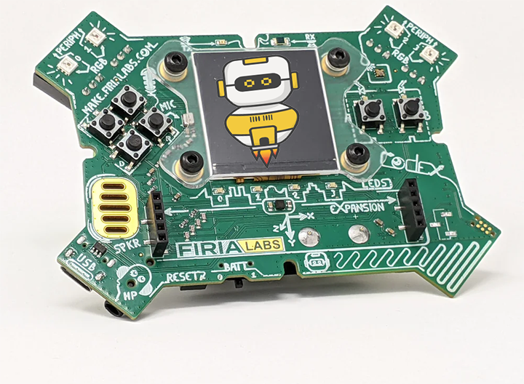
What is CodeSpace?
A powerful online learning and coding environment
Learn to code in Python
Complete missions
Test your code on a physical device

Slide 4

Objective #1: Mission objectives
Objectives are found on the right side of CodeSpace, in a vertical panel
Each objective has at least one goal
Hide the instruction panel by clicking on 1
Unhide the instruction panel by clicking on 1 again

Slide 5
Mission Activity #1
DO THIS:
Hide the instruction panel by clicking on 1
Unhide the instruction panel by clicking on 1 again

Slide 6
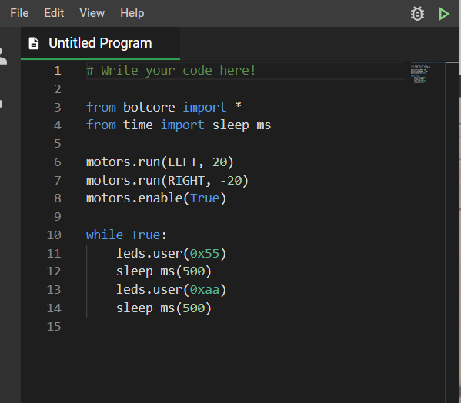
Objective #2: Text editor
The text editor is on the left side of CodeSpace
It is where code will by typed
Make a change to the code

Slide 7
Mission Activity #2
DO THIS:
Click on a line of code in the text editor and make a change
  Change a number
  Add a blank line
  Copy and paste a line of code
  Change True to False
Make a change to the code

Slide 8

Objective #3: Toolbox
The toolbox is in the lower right side of CodeSpace
Right now the toolbox is empty

Slide 9

Mission Activity #3
DO THIS:
Add a “tool” to the toolbox by clicking on
Open the toolbox by clicking the icon
See your word!
Close the toolbox

Slide 10
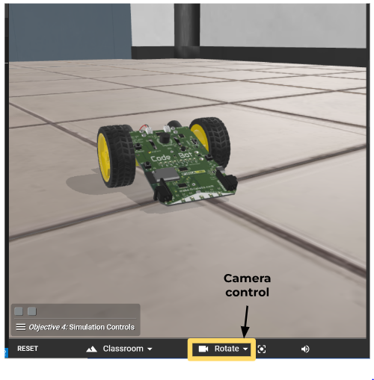
Objective #4: Simulation controls
The camera controls are at the bottom panel of CodeSpace

Slide 11
Mission Activity #4
DO THIS:
Close the instruction panel
Click on the triangle to open the camera controls
Click on help
Close the help panel
Rotate the view to make the scene spin several times

Slide 12

Your first mission quiz
You have learned a lot about CodeSpace. Now …. time for a quiz!
Answer two quiz questions
Read the “completed mission” message and click to complete the mission
CODEX
QUIZ

Slide 13
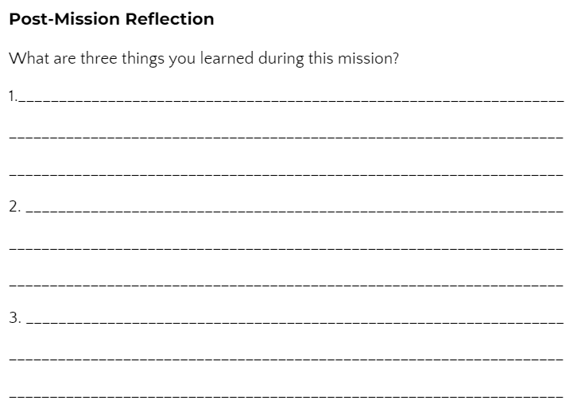
Post-Mission Reflection
Complete your Mission 1 Log

